Slide 1
Asteroids
Roger Tinsley
11501987

Slide 2
Classic Asteroids
Many versions of Asteroids
  Space Ship
  Asteroid
  Laser Pulse
  Scoring
  Collisions

Slide 3
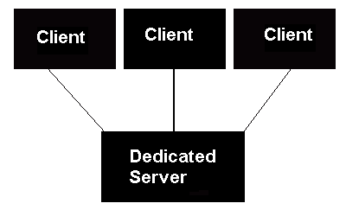
Multiplayer Asteroids
Multiplayer environment
  Dedicated Server
    Console Driven
  Client
    Max clients
    Key listener
    Applet
      Security issues regarding applets
    Sound

Slide 4
Game Objects
Three distinct game objects
  Asteroid
  Ship
    A controllable asteroid
  Laser pulse
Each game object has
  A position
  A velocity

Slide 5
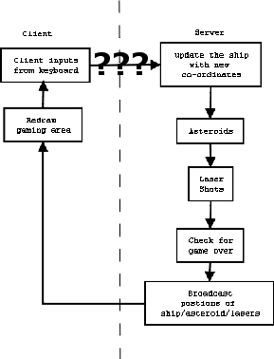
Where to start?
Defining communication channel between client/server. Example commands:
Command Name | Command Id
Move | 1
Turn | 2
Shoot Laser | 3
Add Ship | 4
Client or server reacts to command Id
Diagram showing basic operations of Asteroids

Slide 6
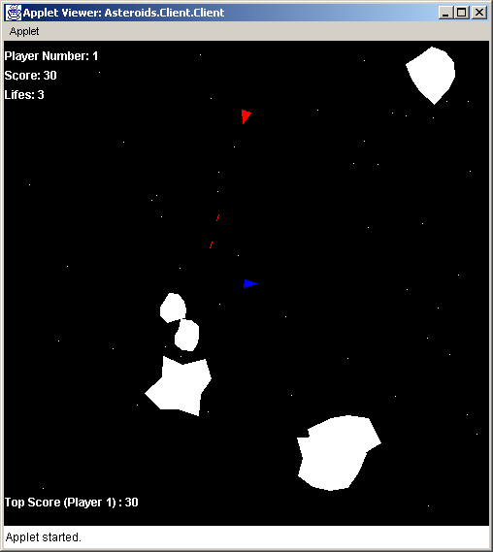
Gaming Area
Game is made up of a gaming area
  Player Id
  Your score
  Top score chart
  Number of lives
  Background
  Scrolling
  Asteroids
  Ships
  Laser pulse
Gaming area is where the game takes place.

Slide 7
Game Scenarios
Number of scenarios can occur in the game:
  Lose a life by
    Collision
    Being shot by another user
  Game over
    Occurs when you lose all your lives
  All user’s game is over
    A message will appear who won the game
  Shoot asteroids/space ships to gain points
    30 points for shooting a big asteroid
    50 points for shooting a small asteroid
    100 points for shooting another space ship
  Splitting/removing Asteroids
    Big asteroid is split into two smaller asteroids
    Small asteroid is removed from the gaming area

Slide 8
Improving Asteroids
Users have a login/password
Chat Server
More animations
Modes of play
Computer controlled objects
Upgrades to ship

Slide 9
Conclusion
Knowledge gained
  Software life cycle
  Client/Server concepts
  Java

